Slide 1
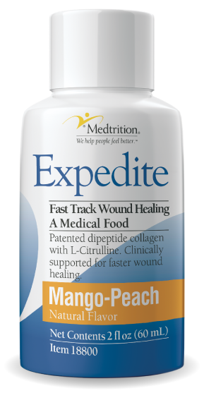
With Gratitude…
Thank you for this opportunity to share information about Expedite.
We are transformative in preventing, reducing, and healing pressure injuries.
Notes:
Hello. Thank you for allowing me to tell you about Medtrition’s newest offering—a medical food that can dramatically improve your wound care protocol.

Slide 2
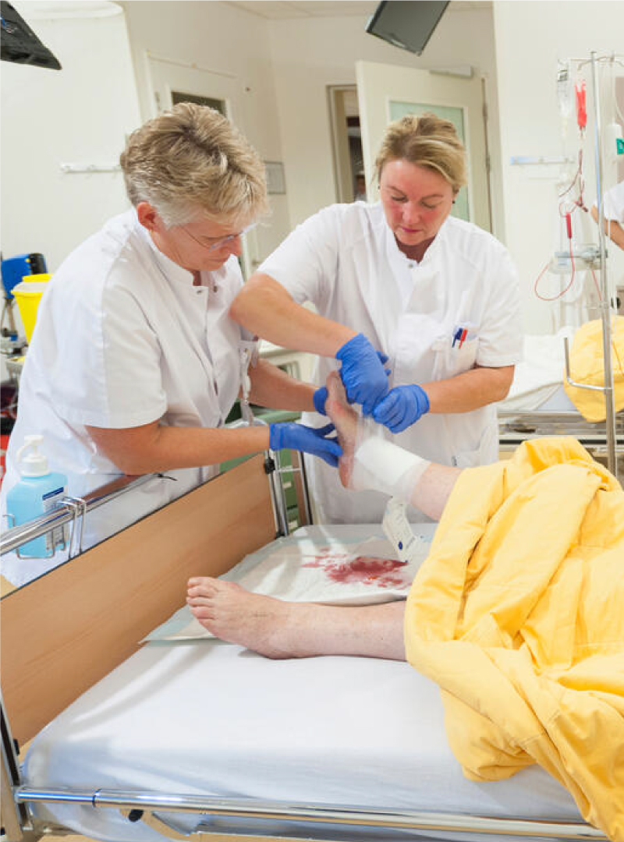
Pressure Injuries Take a Toll on Everyone…
Patients: Pressure injuries can be emotionally devastating and become a major impediment to addressing the original health issue.
Clinicians: Pressure injuries are time consuming and commonly recognized as one of the worst aspects of care.
Facilities: Pressure injuries are costly and erode facility reputation.
Notes:
Hello. Thank you for allowing me to tell you about Medtrition’s newest offering—a medical food that can dramatically improve your wound care protocol.

Slide 3
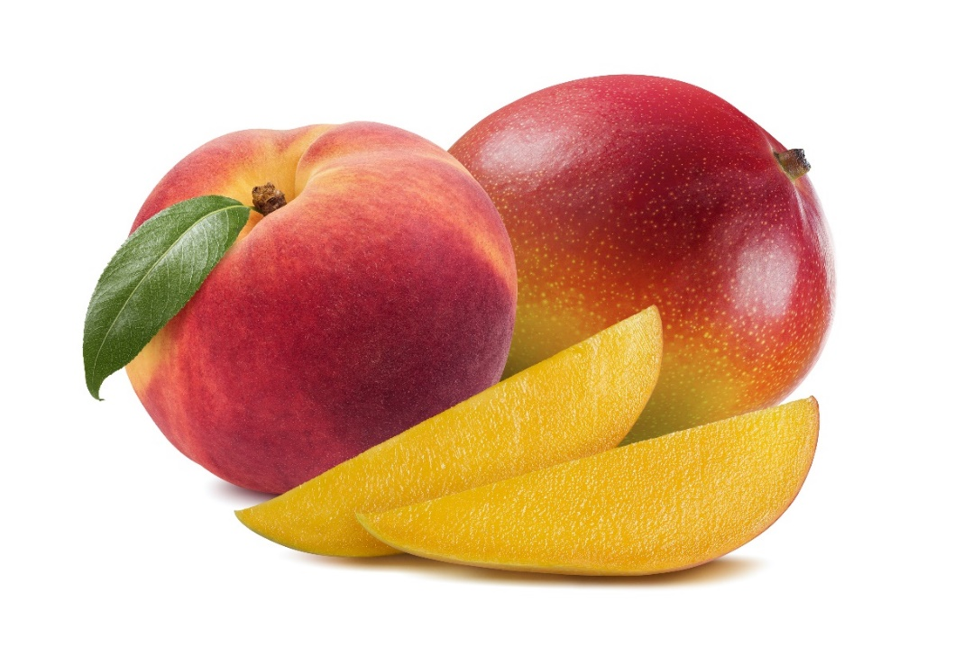
Introducing Expedite:
The ready-to-drink nutritional supplement that will revolutionize the way you treat pressure injuries.
With nurse-ready Expedite, you can
Align nutritional intervention with nursing administration
Dramatically improve compliance
Accelerate healing of pressure injuries
A once a day, 2-ounce, great tasting mango peach liquid supplement

Slide 4
Introducing Expedite
Expedite meets the clinical needs of wound and pressure injury healing and the administration needs of nursing.
An independent survey of healthcare facilities suggests that oral nutrition compliance with wound intervention supplements was as low as 30-50%
Minimal Compliance = Minimal Results

Slide 5
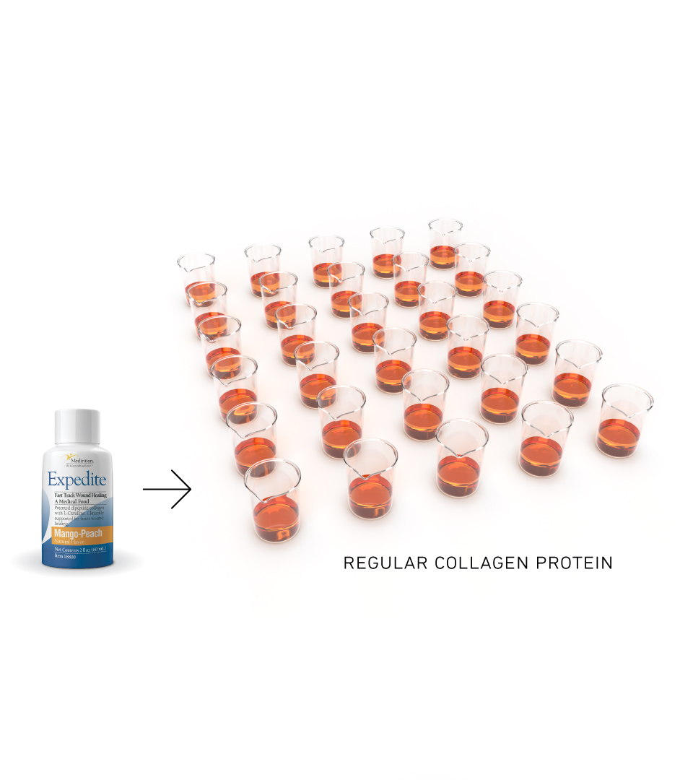
Dipeptides and L-citrulline Super Charge Healing at the Wound Site
Delivers 30 times more bioactive dipeptides, Prolyl-Hydroxyproline (PO) and Hydroxyprolyl Glycine (OG), than regular collagen.
Per gram, L-citrulline, an amino acid, delivers 40% more nitric oxide than L-arginine.

Slide 6
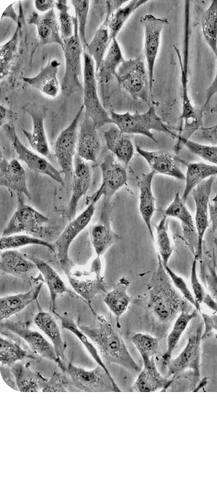
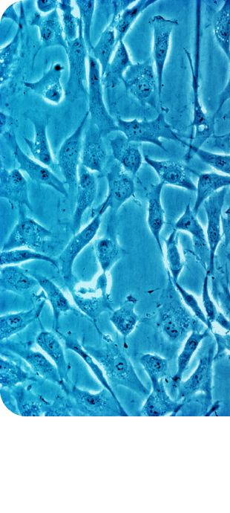
Expedite increases the production of collagen at the wound site
PO & OG are readily absorbed
PO & OG reach the wound site and stimulate the receptors in dermal fibroblasts (skin cells) to proliferate and grow.

Slide 7
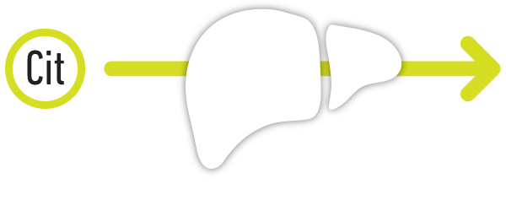
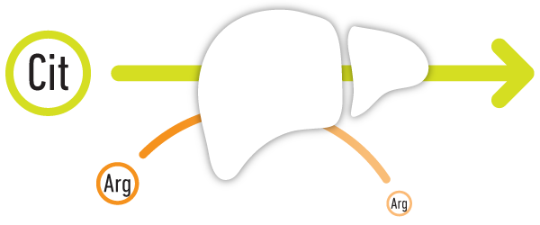
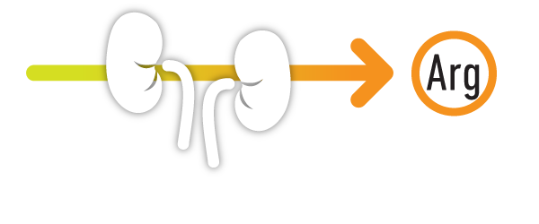
L-Citrulline is a more powerful stimulator of nitric oxide than L-arginine
L-citrulline, an amino acid, is absorbed easily and passes through the liver unchanged.
Unlike ingested L-arginine where 40% is filtered and removed.
L-citrulline is converted to bioavailable arginine in the kidneys
Arginine stimulates the production of nitric oxide bringing blood flow to the wound site

Slide 8
Clinical Evidence:
Significant Improvement in PUSH Score
Study demonstrated:
71.8% of participants experienced significantly increased wound healing, as assessed by PUSH scores.
At least 3X more participants achieved PUSH Score efficacy benchmarks than the control group who received standard care alone.
Notes:
Study available upon request.

Slide 9
Clinical Evidence:
Significant Improvement in PSST Score
Study also demonstrated:
74.4% of participants experienced significantly increased wound healing, as assessed by PSST scores.
Almost 4X more participants achieved PSST Score efficacy benchmarks than the control group who received standard care alone.
Notes:
Study available upon request.

Slide 10
Clinical Evidence:
Significant Reduction in Wound Area
Study also demonstrated:
Increased levels of dermal integrity in patients with stage 2 or stage 3 pressure injuries, when compared to the placebo group receiving standard of care alone.
More rapid re-epithelialization of tissue, leading to significant reduction in wound area, compared to placebo group.
Notes:
Study available upon request.

Slide 11
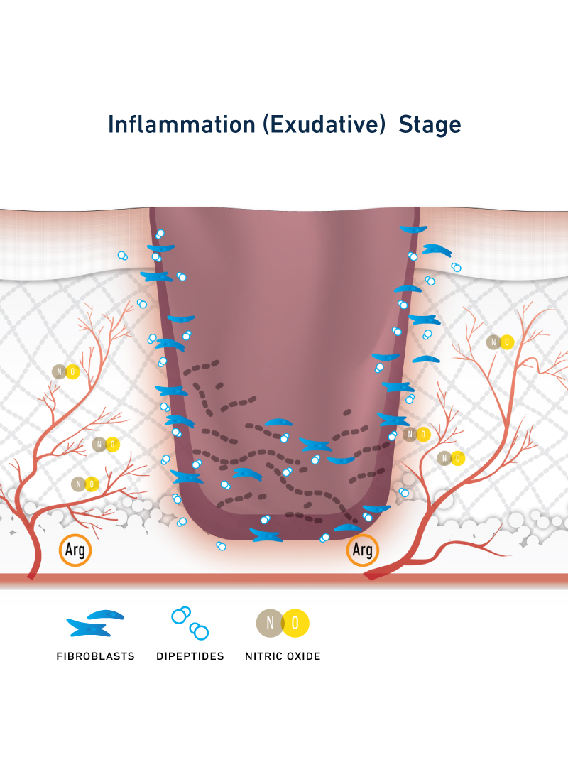
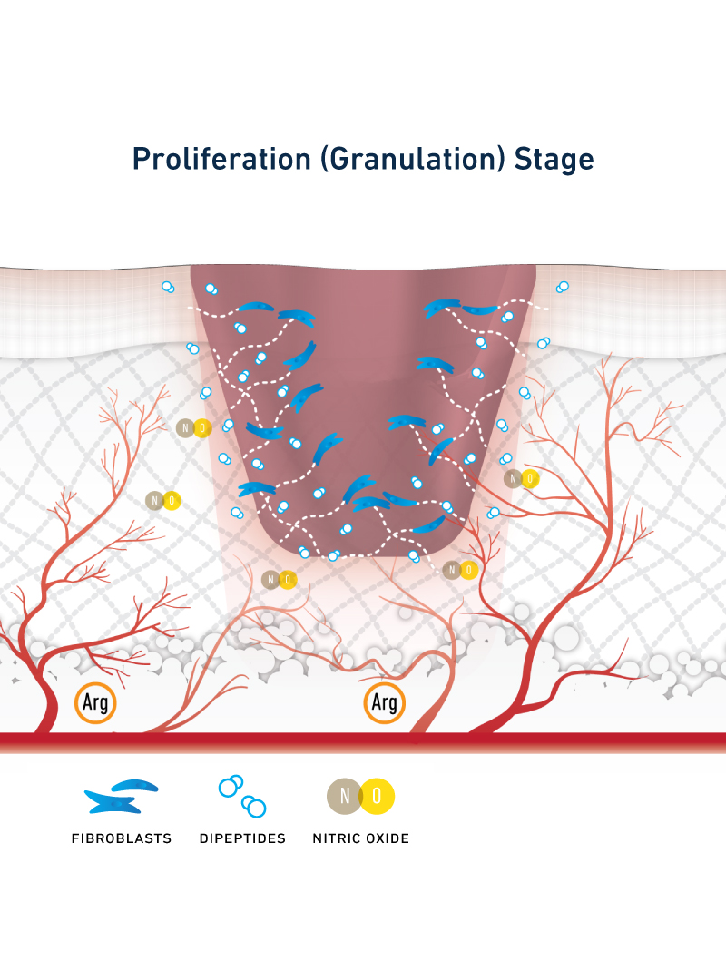
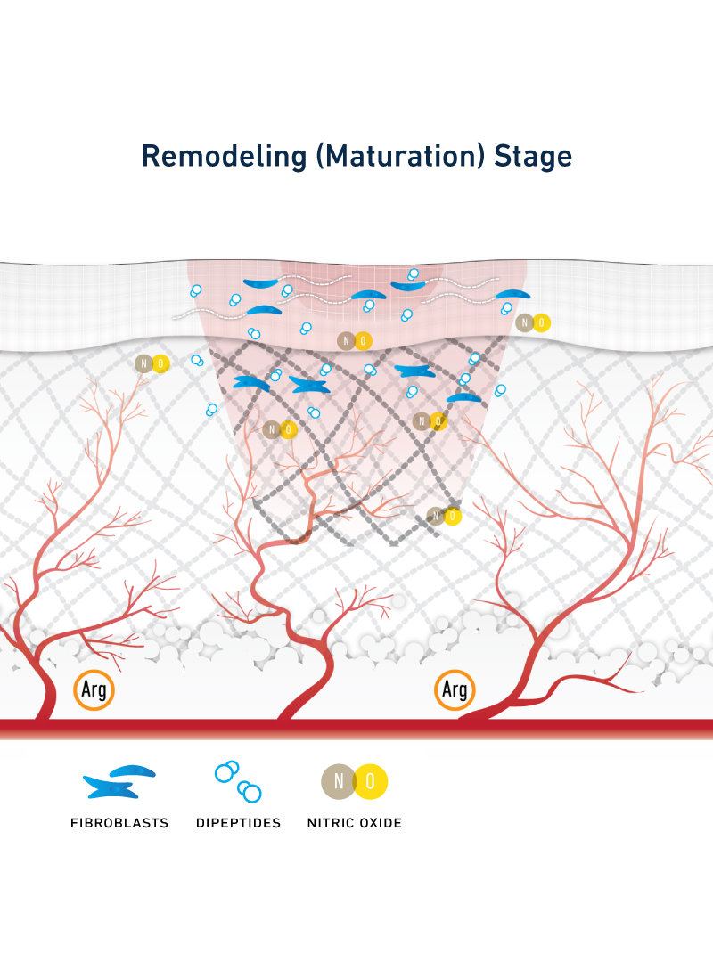
Expedite Works at Every Stage of Wound Healing
At the Inflammation Stage:
dipeptides act on skin cells which aid in breaking down damaged collagen.
Arginine is a precursor of nitric oxide (NO), a vasodilator which brings oxygen and nutrients to the wound site.
At the Proliferation Stage:
PO & OG stimulate receptors in dermal ﬁbroblasts to produce collagen.
Promotes hyaluronic acid synthesis, required for maintaining dermal integrity.
Nitric oxide stimulates angiogenesis, the formation of new blood vessels to support wound site reconstruction
At the Remodeling Stage:
Expedite dipeptides continue to stimulate collagen synthesis, strengthening tissue as the wound continues to contract and ﬁbers are reorganized.
Stimulates re-epithelialization, accelerating wound healing and increasing dermal moisture retention.

Slide 12
Put Wound Healing on the Fast Track with Expedite
Poor compliance and prolonged interventions are creating a physical, emotional and financial drain. Expedite is your answer.
Formulated to accelerate healing and eliminate barriers to compliance, Expedite simplifies treatment and improves patient outcomes and quality of life.
Everyone benefits from the healing power of Expedite! Patients and families, nurses and nutrition, physicians and administration.

Slide 13
Expedite makes compliance easy
Administration + Compliance = Fast Tracked Wound Healing
Great-tasting: patients like the flavor
No mixing or preparation needed
One 2 oz. serving per day, instead of 8-10 oz., 2X per day
Easily added to overall fluid intake
Simple administration without risk of clogging tubes for enteral tube feeding
Nurses love how much easier Expedite is to administer

Slide 14
Get on the Fast Track with Expedite, Today
Let’s get started today!
You, your residents, their families, and your administrators are sure to be thrilled with the results!
Start with patients where compliance is an issue
Add Expedite to the wound care tool kit for all topical wound care presentations.
Address benefits of product with both nursing and nutrition to ensure patients and residents at risk are being identified
Notes:
Do you have a patient or group of pressure injury patients that are stubbornly difficult to treat? Give Expedite a try! We’ll start by delivering one case of 48 2 fl. oz. bottles directly to your facility by tomorrow. Thank you!

Slide 15
Thank you for your time and attention
Questions??
Notes:
Do you have a patient or group of pressure injury patients that are stubbornly difficult to treat? Give Expedite a try! We’ll start by delivering one case of 48 2 fl. oz. bottles directly to your facility by tomorrow. Thank you!

Slide 16
Clinical References
Sugihara F, Inoue N, Venkateswarathirukumara S. Ingestion of bioactive collagen hydrolysates enhanced pressure ulcer healing in a randomized double-blind placebo-controlled clinical study. Sci Rep. 2018;8(1):11403. Published 2018 Jul 30. doi:10.1038/s41598-018-29831-7
Inoue N, Sugihara F, Wang X. Ingestion of bioactive collagen hydrolysates enhance facial skin moisture and elasticity and reduce facial ageing signs in a randomized double-blind placebo-controlled clinical study. J Sci Food Agric. 2016 Sep;96(12):4077-81. doi: 10.1002/jsfa.7606. Epub 2016 Feb 10. PMID: 26840887.
Sugihara, Fumihito & Inoue, N. & Wang, X.. (2015). Clinical effects of ingesting collagen hydrolysate on facial skin properties: A randomized, placebo-controlled, double-blind trial. Japanese Pharmacology and Therapeutics. 43. 67-70.
Kimira, Yoshifumi & Ogura, Kana & Taniuchi, Yuri & Kataoka, Aya & Inoue, Naoki & Sugihara, Fumihito & Nakatani, Sachie & Shimizu, Jun & Wada, Masahiro & Mano, Hiroshi. (2014). Collagen-derived dipeptide prolyl-hydroxyproline promotes differentiation of MC3T3-E1 osteoblastic cells. Biochemical and Biophysical Research Communications. 453. 10.1016/j.bbrc.2014.09.121.
Shimizu, Jun & Asami, Naoto & Kataoka, Aya & Sugihara, Fumihito & Inoue, Naoki & Kimira, Yoshifumi & Wada, Masahiro & Mano, Hiroshi. (2014). Oral collagen-derived dipeptides, prolyl-hydroxyproline and hydroxyprolyl-glycine, ameliorate skin barrier dysfunction and alter gene expression profiles in the skin. Biochemical and biophysical research communications. 456. 10.1016/j.bbrc.2014.12.006.
Sugihara F, Inoue N, Kuwamori M, Taniguchi M. Quantification of hydroxyprolyl-glycine (Hyp-Gly) in human blood after ingestion of collagen hydrolysate. J Biosci Bioeng. 2012 Feb;113(2):202-3. doi: 10.1016/j.jbiosc.2011.09.024. Epub 2011 Oct 29. PMID: 22040651.
Nakatani S, Mano H, Sampei C, Shimizu J, Wada M. Chondroprotective effect of the bioactive peptide prolyl-hydroxyproline in mouse articular cartilage in vitro and in vivo. Osteoarthritis Cartilage. 2009 Dec;17(12):1620-7. doi: 10.1016/j.joca.2009.07.001. Epub 2009 Jul 8. PMID: 19615963.

